Slide 1






Our Lady & St John’s
Primary School
Calculation
Policy
Examples of calculation methods for each year
group and the progression between each method

Slide 2










Our Calculation Policy
This calculation policy has been created to meet the expectations of the new national curriculum but most importantly the learning needs of our children at
Our Lady & St John’s. The methods chosen match the national curriculum but have also been specifically selected after consideration of our children’s learning styles.
Age Expectations
The policy has been organised by year group, considering the national curriculum 2014 expectations. The new curriculum focuses on skills and mastery and is not about moving children on to the next method as soon as they can do the one before. Working and more complex and richer problems rather than new methods will support this ‘mastering’ of maths. However, some children will be working at levels well above their age and will require the introduction of new methods.
Mental Methods
The written methods in this document are important but they by no means replace the superb mental methods we have developed. As children become more mature and confident with their calculation, they need to start following these 4 steps when approaching problems:
1) Can I solve it in my head and use a mental method?
2) Do I need to use some written jottings
to help me?
3) Do I need to use a written method to solve this problem?
4) Do I need to use a
calculator to get an
answer?

Slide 3


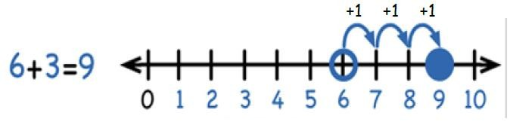


Addition
Focus: Adding with numbers up to 20
Children should use number lines (with the numbers on) to add by counting in ones.
Starting with the greatest number and counting on the smaller number.
As well as using a numberline, children in Year 1 need to:
Use a variety of equipment to solve addition problems, including counting equipment, everyday objects, number tracks, numicon, hundred square, base tens etc.
Read and write the addition (+) and equals (=) sign and use them in number
sentences.
Solve addition number sentences and missing number problems: 7 + 4 = ?, 1 + 2 +
1= ?, ? + ? = 9 etc.
Use bead strings or bead bars to visualise bridging through 10s e.g. 8 + 5 = can be solved by counting on 2 then counting on 3.
Key Vocabulary
Add, more, plus, and, make, altogether, total, equal to, equals, the same as, double, most, count on, numberline
Key Skills
Reading and writing numbers to 100 in numerals.
Writing numbers to 20 in words including correct spelling.
Counting to and across 100 in ones.
Counting in multiples of 2, 5 and 10.
Solving simple one step addition problems: using objects, numberlines and images to support.
Year One

Slide 4


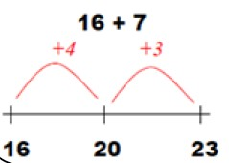

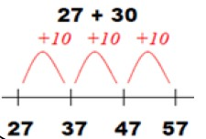

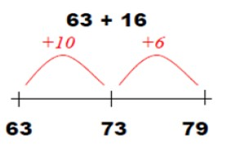










Addition
Focus: Adding with 2 digit numbers.
Children should explore and understand how to use blank numberlines to add using their knowledge of place value and how to partition numbers in different ways. Once confident they should move onto written partitioning methods.
Adding a 2 digit number and tens
Adding a 2 digit number and units
Adding two 2 digit numbers
34 + 23 = 57
30 + 20 = 50
4 + 3 = 7
58 + 43 = 101
78 + 47 = 125
70 + 40 = 110
8 + 7 = 15
50 + 40 = 90
8 + 3 = 11
Partitioning should be started with 2 digit numbers that do not bridge the tens or hundreds so children become fully confident with the method itself.
Start this by partitioning using base 10 or using a hundred square to jump in steps of 10’s or 1’s.
Once children are
confident they can start using the partitioning method to add numbers that bridge the tens and hundreds boundaries.
Key Vocabulary
Add, more, plus, and, make, altogether, total, equal to, equals, the same as, double, most, count on,
numberline, sum, tens, units, ones, partition, addition, column, tens boundary
Key Skills
Add a 2 digit number and units and a 2 digit number and 10s.
Add pairs of 2 digit numbers.
Add three single digit number.
Know and show that adding can be done in any order (the commutative law).
Recall bonds to 20 and multiple of 10 bonds to 100.
Count in steps of 2,3 and 5 and count in 10s from any number.
Understand the place value of 2 –digit numbers (tens and ones).
Compare and order numbers to 100 using < > and = signs.
Read and write numbers to at least 100 in numerals and words.
Solve contextual addition problems.
Year Two

Slide 5











Addition
Focus: Adding with numbers up to 3 digits
In year 3 we will move to the traditional column method and to support this, children will first apply their partitioning skills to the partitioning column method.
246 + 132 = 378
200 + 40 + 6
100 + 30 + 2
Introduce the partitioning
337 + 188 = 525
300 + 30 + 7
100 + 80 + 8
400 + 110 + 15 = 525
Once confident, children can start using the
column method with numbers that do not bridge so children become confident with the
partitioning column
method to solve problems that bridge the tens and hundreds boundaries.
method itself.
300 + 70 + 8 = 378
Add units first!
116 + 343= 459
Now children are ready to move
245 + 84 = 329
on to the traditional column
343
+ 116
459
methods. Introduce this initially with numbers that do not bridge any boundaries. It is important
245
+ 84
329
1
Once the method is secure children
are now ready to be introduced to ‘carrying’ which happens when bridging in the column method. Make sure children add the units first and ‘carry’ numbers under the
children remember that it is
three hundred add one hundred,
NOT 3 + 1!
bottom line.
Key Vocabulary
Add, more, plus, and, make, altogether, total, equal to, equals, the same as, double, most, count on, numberline, sum, tens, units, ones, partition, addition, column, tens boundary, hundreds boundary, increase, vertical, carry, expanded, compact
Key Skills
Read and write numbers to 1000 in numerals and words.
Add 2 digit number mentally including those that bridge 100.
Add a 3 digit number and ones, a 3 digit number and 10s and a 3 digit number and 100s mentally.
Estimate answers to calculations, using the inverse operation to check.
Solve problems, including missing number problems using number facts and place value.
Recognise the place value of each digit in a 3 digit number (hundreds, tens and units).
Continue to practice many different mental addition strategies including adding to the nearest multiple of 10, 100, 1000 and adjusting, using number bonds, using near doubles, partitioning and recombining etc.
Year Three

Slide 6





Addition
Focus: Adding with numbers up to 4 digits
In year 4 children will consolidate their use of the traditional column method and will be able to use it confidently to add numbers up to 4 digits. This could include carrying units, tens and hundreds.
4267 + 1584 = 5851
4267
+ 1584
5851
1 1
Children should already be familiar with the column method from year 3 but it is very important to go over the method again ensuring children understand why they start with the units, have to carry
a number etc.
Remember!
The units must be added first!
‘Carry’ numbers underneath the bottom line!
Reinforce the place value! It is not 6 add 8, it is 6 tens add 8 tens!
Key Vocabulary
Add, more, plus, and, make, altogether, total, equal to, equals, the same as, double, most, count on,
numberline, sum, tens, units, ones, partition, addition, column, tens boundary, hundreds boundary, increase, vertical, carry, expanded, compact, thousands, hundreds, digits, inverse.
Key Skills
Select most appropriate method: mental, jottings or written and explain why.
Recognise the place value of every digit in a 4 digit number.
Round any number to the nearest 10, 100 or 1000.
Estimate and use inverse operations to check answers.
Solve 2 step problems in different contexts, picking the correct operation to use.
Find 100 more or less than a number.
Continue to use a wide range of mental addition methods.
Add numbers with up to 4 digits using column addition.
Year Four

Slide 7

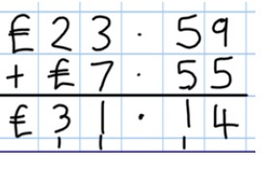
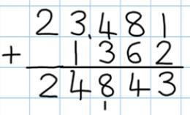

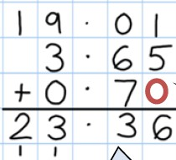


Addition
Focus: Adding with more than 4 digits
In year 5 children will now use the column method to add decimal numbers in the context of money and measures. It is important that children have place value skills beyond 4 digits here and fully understand what a decimal number represents.
The decimal point needs to be lined
up just like all of the other place value columns and must be remembered in the answer column.
It is important children understand why this is and get into this habit very quickly.
Children should be working with numbers greater than 4 digits including numbers in the ten thousands and hundred thousands.
Children need to start using the column method to add more than two values, still considering place value very carefully.
Remember!
It is important that children say 6 tenths add 7 tenths so they understand that they are adding part of a number not a whole number.
Empty places should be filled with a zero to show the value of that place.
Key Vocabulary
Add, more, plus, and, make, altogether, total, equal to, equals, the same as, double, most, count on, numberline, sum, tens, units, ones, partition, addition, column, tens boundary, hundreds boundary, increase, vertical, carry, expanded, compact, thousands, hundreds, digits, inverse, decimal place, decimal point, tenths, hundredths, thousandths.
Key Skills
Add increasingly large numbers mentally using an expanding range of strategies.
Use rounding to check answers and make estimates.
Understand the place value of tenths and hundredths.
Solve multi step problems in different contexts, deciding which operations and methods to use and explaining why.
Read, write, order and compare number to 1 million.
Round any number to 1 million to the nearest 10, 100, 1000, 10 000 or 100 000.
Add numbers with more than 4 digits using column addition.
Read Roman numerals
Year Five

Slide 8



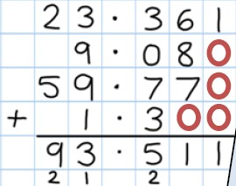
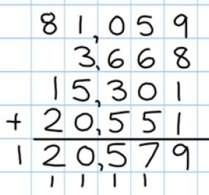

Addition
Focus: Adding several numbers with an increasing level of complexity
In year 6 children need to use all the previous adding skills developed to add several numbers with a variety of different decimal places. Many of these problems will be in the context of money or measures.
Children should also continue to add multiple integers with 4 digits or more.
Children need to use their knowledge of the decimal point to line up their amounts correctly in the column. Zeroes should be added to support place value, showing that there is no value to add.
Key Vocabulary
Add, more, plus, and, make, altogether, total, equal to, equals, the same as, double, most, count on, numberline, sum, tens, units, partition, addition, column, tens boundary, hundreds boundary, increase, vertical, carry, expanded, compact, thousands, hundreds, digits, inverse, decimal place, decimal point, tenths, hundredths, thousandths, integer
Key Skills
Solve problems mentally, including those with mixed operations and large numbers, using all the mental strategies learnt in previous years.
Solve multi step problems in context, deciding which operations and methods to use,
Use estimation to check answers to a calculation.
Read, write order and compare numbers to 10 million and understand the value of each digit.
• Round any whole number to the nearest 10, 100, 1000, 10 000, 100 000, 1 000 000 or 10 000 000
Round decimal numbers to the nearest whole number.
Year Six

Slide 9







Subtraction
Focus: Subtracting from numbers up to 20
In year 1, children will use numberlines, objects and visual models to understand subtraction as taking away but also as the difference between or distance between two numbers.
For 7 take away 4, the child would start on
the numberline at 7 and count back 4 in ones.
Hundred squares, number tracks, counting objects and real life objects should all be used as well to explore subtraction in a variety of practical contexts.
This would give them the answer 3.
To answer problems such as how many more is 7 than 4 or what is the difference between 7 and 4, cubes should be made into rods so children can see the problem visually. This method can also be used to answer ‘find the distance’ problems.
Mental subtraction is equally important in year 2 and children should practice recalling subtraction facts up to and within 10 and 20. In year 1 children should also be taught about subtracting zero.
Key Vocabulary
Equal to, take, take away, less, minus, subtract, leaves, distance between, difference between, how many more, how many fewer/less than, most, least, count back, how many left, how much less is_?
Key Skills
Given a number, say one more or one less.
Count to and over 100, forward and back from any number in 1s.
Represent and use subtraction facts to 20 and within 20.
Subtract with one digit and 2 digit numbers to 20, including zero.
Solve one step problems that involve subtraction using objects, pictures and numbered lines.
Read and write numbers to 100 in numerals.
Write numbers in words to 20s, including correct spelling.
Year One

Slide 10




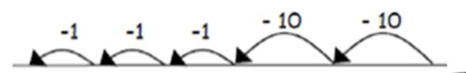



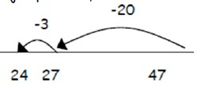
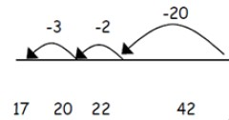

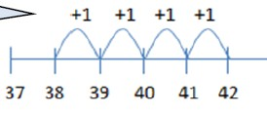

Subtraction
Focus: Subtracting with 2 digit numbers
In year 2 children will start to use blank numberlines to subtract by counting back which will greatly support the development of mental subtraction skills. Base 10 is also a super subtraction tool and should be used alongside blank numberline methods.
For 47 – 23 = 24, children should start by partitioning the tens number and subtracting that first by counting back in tens. They will then subtract the units number and subtract that by counting back in 1s.
24
25
26
27
37
47
Once children develop their confidence of counting back they will be able to select more efficient jumps to solve a problem and will not have to partition the tens and units numbers
Once confident with efficient jumps, children are ready to subtract by bridging through 10, again partitioning is very important here and the children will need to be very confident with partitioning in different ways.
separately.
Counting on as a mental method
Counting on is a super mental method! It is especially useful for finding the difference problems and numbers that are close together. It is important that children understand that although they are counting on, they are finding the difference which is subtraction!
Always keep the first number the same.
Key Vocabulary
Equal to, take, take away, less, minus, subtract, leaves, distance between, difference between, how many more, how many fewer/less than, most, least, count back, how many left, how much less is_?, count on, strategy, partition, tens, units
Key Skills
Recognise the place value of each digit in a 2 digit number.
Recall and use subtraction facts to 20 fluently, use to derive related facts to 100.
Subtract using objects, images, 100 squares and mentally including a two digit number and ones, a two digit number and 10s and two 2 digit numbers.
Understand and show that subtraction calculations cannot be done in any order.
Use the inverse relationship between + and – to check calculations and solve missing number problems.
Solve simple subtraction problems in context using written and mental methods.
Read and write numbers to at least 100 in numerals and words.
Year Two

Slide 11



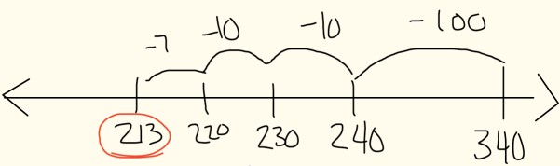
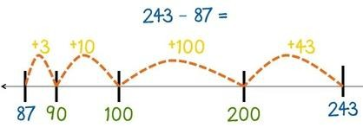


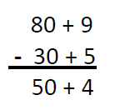

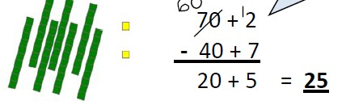

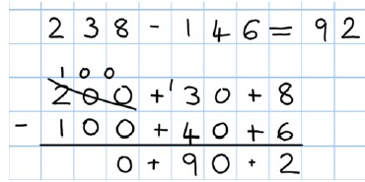

Subtraction
Focus: Subtracting with 2 and 3 digit numbers
Children will consolidate their knowledge of counting back and counting on using a blank numberline to subtract. They will use these methods both written and mentally. Once children become fully confident they will be ready to move on to the partitioning column method of subtraction. Children will also be introduced to the traditional column method.
Children will continue to subtract on a
numberline using efficient jumps and now
Counting on will also be used for problems greater than 100 using efficient jumps, the use of 100 square can support children’s understanding of this method.
apply these to 3 digit number problems. Here is an efficient example of 340 – 127=
Children will now have the mental skills
required to approach the partitioning column method of subtraction. At first they should attempt this where no exchanging is required. Here is an example for 89 – 35 = 54
Through practical subtraction children should be introduced
to exchanging. Base 10 is a vital tool here as is a solid grounding with partitioning in different ways. It is important children
realize that the value has not changed, we have just partitioned in a different way.
As you can see here for 72 – 47, before subtracting 7 units, a tens row will need to be exchanged for 10 units.
Children who are secure with the concept of ‘exchanging’ should now be able to use the partitioning column method to subtract any 2
Key Vocabulary
Equal to, take, take away, less, minus, subtract, leaves, distance between, difference between, how many more,
how many fewer/less than, most, least, count back, how many left, how much less is_?, count on, strategy, partition, tens, units, exchange, decrease, hundreds, value, digit
Key Skills
Subtract mentally: a 3 digit number and 1s, a 3 digit number and 10s and a 3 digit number and 100s.
Estimate answers and use the inverse to check.
Solve problems in different contexts, including missing number problems.
Find 10 or 100 more or less than a given number.
Recognise the place value in a 3 digit number, 100s, 10s and 1s.
Solving finding the difference problems using counting on.
Reading and writing numbers up to 1000 in numerals and words.
Practise and develop mental strategies including subtracting near multiples of 10 and adjusting, counting on etc.
Year Three

Slide 12


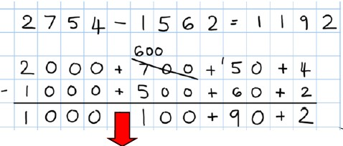

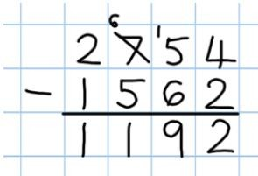


Subtraction
Focus: Subtracting with numbers up to 4 digits
Children will consolidate their knowledge of the partitioning column method for subtraction with 4 digit numbers including those where exchanging is required. Once they
are secure with this they will move on to the compact (traditional) method of column subtraction.
Children will consolidate their learning of the partitioning column method of subtraction and exchanging by solving calculations with more complex numbers. Place value counters will come in handy here when building children’s confidence. Money can also be partitioned for subtraction e.g. £1 + 30 + 5 - £1 + 10 + 2 =
Once confident children are ready to move on to the compact method of subtraction. Encourage children to complete a calculation in the partitioning column methods and then model compact method. See if children can see how they are linked and discuss which is simpler.
Although this is seen as the ‘easiest’ method it does not mean that it is necessarily the best method and they need to carefully select the best method for the problem they are solving.
Key Vocabulary
Equal to, take, take away, less, minus, subtract, leaves, distance between, difference between, how many more, how many fewer/less than, most, least, count back, how many left, how much less is_?, count on, strategy, partition, tens, units, exchange, decrease, hundreds, value, digit, inverse.
Key Skills
Subtract by counting on where numbers are close together or they are near to multiples of 10, 100 etc.
Children select a mental, written or jotting method depending on what the problem requires.
Children estimate and use the inverse operation to check a problem.
Children solve 2 step problems involving + and -, picking the correct operation and method.
Children solve simple money and measure problems with fractions and decimals.
Find 1000 more or 1000 less than a given number.
Count backwards through zero including negative numbers.
Recognise the place value of each digit in a 4 digit number.
Round any number to the nearest 10, 100 or 1000.
Solve number and practical problems that involve increasingly large positive integers.
Year Four

Slide 13

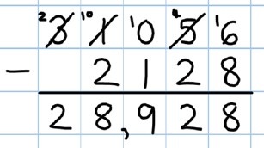




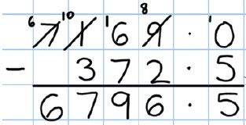

Subtraction
Focus: Subtracting with numbers beyond 4 digits including decimals
Children in year 5 will continue to use the compact column method of subtraction to solve problems including those where exchanging is required. They will subtract larger integers and begin to subtract decimal amounts.
Children will come across problems where
exchanging will need to take place several times to
complete the problem.
Where there is a space in a column it is important that children add a zero so they understand the value and know what to subtract in that column.
Once confident with large integers, children will now be ready to move onto decimal numbers including lots in the context of measures and money. Just like addition, it is important that the children line up the decimal point and understand why they are doing this.
Key Vocabulary
Equal to, take, take away, less, minus, subtract, leaves, distance between, difference between, how many more, how many fewer/less than, most, least, count back, how many left, how much less is_?, count on, strategy, partition, tens, units, exchange, decrease, hundreds, value, digit, inverse, tenths, hundredths, decimal place, decimal
Key Skills
Subtract mentally with increasingly large numbers.
Subtract whole numbers with more than 4 digits. Including using formal written methods.
Use rounding and estimation to check answers to calculations.
Solve addition and subtraction multi step problems, deciding which operations to use and why.
Read, write, order and compare numbers to at least 1 million and understand the value of each digit.
Count forwards or backwards in steps of powers of 10 up to 1 million.
Understand negative numbers in context and count forwards and backwards through 0.
Round any number up to 1 million to the nearest 10, 100, 1000, 10 000 and 100 000.
Year Five

Slide 14


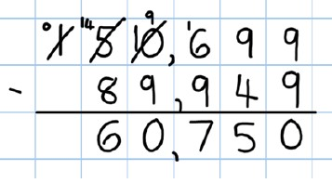


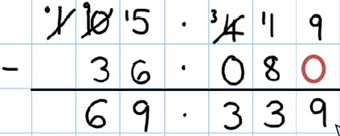

Subtraction
Focus: Subtracting with increasingly complex numbers including decimals
In year 6, children need to use mental methods and the compact column method of subtraction to solve an increasingly complex range of calculation including those with integers, those with decimals and those with mixed numbers.
Children will use the compact method to solve problems involving integers up to 6 digits and beyond and solve problems where they will need to use ‘exchanging’ several times.
They will also solve problems in context involving increasingly large decimals. They will need to continue using their knowledge of decimal points to line up their numbers and place zeroes in any empty places so they fully understand the value of that column.
Key Vocabulary
Equal to, take, take away, less, minus, subtract, leaves, distance between, difference between, how many more, how many fewer/less than, most, least, count back, how many left, how much less is_?, count on, strategy, partition, tens, units, exchange, decrease, hundreds, value, digit, inverse, tenths, hundredths, decimal place, decimal
Key Skills
Solve addition and subtraction multi step problems in context, deciding which operations to use and why.
Read, write, order and compare numbers to at least 10 million and understand the value of each digit.
Round any whole number up to 10 million to the nearest 10, 100, 1000, 10 000, 100 000, or 1 million.
Use negative numbers in context and calculate intervals across zero.
Look at a calculation and decide whether you need to use a mental method, a jotting, a written method or a calculator to solve.
Year Six

Slide 15

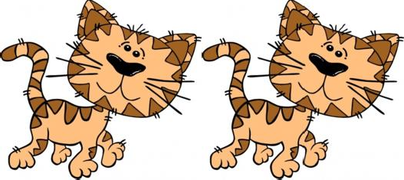


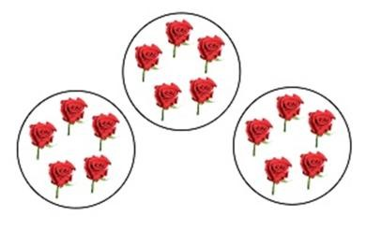

Multiplication
Focus: Repeated addition with objects, arrays and pictorial representations.
In year one children will be exposed to many different multiplication based activities in a variety of contexts. Much of this will be repeated addition activities or be linked to counting in 2s, 5s or 10s.
How many legs will 2 cats have?
Children use images and pictorial representations to solve simple problems that involve repeated addition. They may wish to use the picture to support or use other equipment.
Adult support at this stage is to be expected.
4
+
4
= 8
Some children may start to see the link between the
problem below and counting in 5s and be able to use mental
skills to solve the problem.
There are 5 roses in each garden. How many roses in 3 gardens?
5 + 5 + 5 = 15
Key Vocabulary
Groups of, lots of, times, array, altogether, multiply, count
Key Skills
Count in multiples of 2,5 and 10.
Solve 1 step problems involving multiplication using objects, arrays or pictures with support.
Make connections between arrays and counting in 2s, 5s and 10s.
Begin to understand doubling using objects and pictorial representations.
Solve practical problem solving activities counting equal sets or groups.
Have lots of practice counting and bundling groups of objects into 2s, 5s and 10s.
Year One

Slide 16






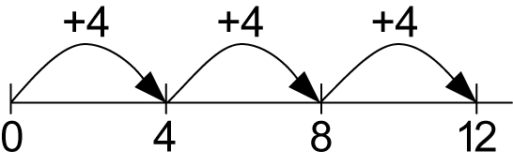




Multiplication
Focus: Multiplying using arrays and repeated addition- 2,3,4,5,10x table facts
In year 2 children will be aware of simple arrays and pictorial representations and understand what they mean. In year 2 children will develop the knowledge of how to
make their own arrays to solve a problem and also how repeated addition on a numberline can get them to a solution.
Arrays are super for children to solve the answer to simple
problems. They are also great for showing children the commutative law, for example, if you turned this array for 3
4 x 3 = 12
x4 = 12 sideways you would see that 4 x 3 also equals 12.
3 x 4 = 12
3 x 4 = 4 + 4 + 4 = 12
4 x 3 = 3 + 3 + 3 + 3 = 12
Repeated addition is a good progression from arrays. It
encourages the children to use addition facts on a blank numberline and count up to their answer as shown on the example above which models that 3 x 4 = 12.
Mental methods and practical apparatus are still very important at this stage. Visual images such as the bead string to the left that demonstrates 6 x 5 = 30 will support children’s visualization of multiplication and allow them to develop stronger mental skills.
Key Vocabulary
Groups of, lots of, times, array, altogether, multiply, count, multiplied by, repeated addition, column, row, commutative, sets of, equal groups, times as big as, once, twice, three times
Key Skills
Count in steps of 2,3 and 5 from zero and in 10s from any number.
Recall and use multiplication facts for the 2,5 AND 10 times tables.
Recognise odd and even numbers.
Write and calculate number statements using the x and = signs.
Show that multiplication can be done in any order (the commutative law).
Solve a range of multiplication problems using objects, arrays, repeated addition, mental methods and
multiplication facts.
Use and become familiar with all of the above multiplication language.
Year Two

Slide 17


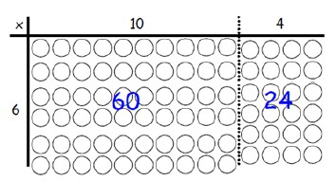

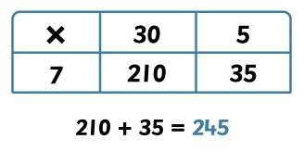

Multiplication
Focus: Multiplying 2 digit numbers by 1 digit numbers
In year 3 children will move on from arrays and start using the grid method of multiplication. It is essential that before children move onto the grid method they are
completely confident with all previous methods and have a solid grounding with mental methods and partitioning. Children are also introduced to formal written methods.
Before moving on to grid multiplication, children need to be able to …
Partition numbers into tens and units
Multiply single digits by multiples of 10 (3 x 30 = 90).
Quickly recall multiplication facts for the 2,3,4,5,6 and 10 x tables.
Use any previous method to work out unknown multiplication facts, quickly and accurately.
The grid method should be introduced using an arrays model such as the one to the left for 14 x 6. Children need to use their partitioning skills to partition the two digit number and then use their existing knowledge of arrays to come to an answer with minimal support.
Multiplication grid method requires good organization but also
a solid understanding of partitioning and multiplication facts, as you can see in the example to the right for 35 x 7. The children need to remember that once they have multiplied the partitioned parts of the number, they then need to add the two
Key Vocabulary
Groups of, lots of, times, array, altogether, multiply, count, multiplied by, repeated addition, column, row, commutative, sets of, equal groups, times as big as, once, twice, three times, partition, grid method, multiple, product, tens, units, value
Key Skills
Recall and use multiplication facts for the 2,3,4,5,6 and 10 multiplication tables and multiply multiples of 10.
Write and calculate number sentences using known x tables.
Answer 2 digit x 1 digit problems using mental and written methods.
Solve multiplication problems in context including missing number problems.
Develop mental strategies using commutativity (e.g. 4x12x5=4x5x12=20x12=240) and for missing number problems.
Year Three

Slide 18
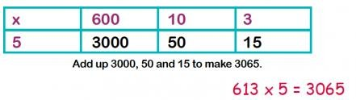


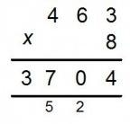


Multiplication
Focus: Multiplying 2 and 3 digit numbers by 1 digit numbers
In year 4 children need to use the grid method confidently to solve problems where a 2 or 3 digit number is multiplied by a one digit number. They need to move on to the use of short multiplication to solve 3 digit number multiplied by 1 digit problems.
The grid method is extended in year 4 so children will now
multiply 3 digit numbers by 1 digit numbers. When adding the 3 answers up to create a total, column addition could be used to
ensure accuracy, especially where bridging will be needed.
The compact ‘short multiplication’ method is tricky and needs to be approached carefully. At first children should solve a problem using grid method and then observe the teacher solve a problem using short multiplication and make comparisons. How are they similar? Children need to go through it very slowly and carefully, unpicking each step until they are fully confident.
It is at this stage that approximation and estimation should become a regular part of classroom practice. Children should approximate an answer before using a method so they know if there answer is accurate or not.
253 x 9 is approximately 250 x 10 = 2500
Key Vocabulary
Groups of, lots of, times, array, altogether, multiply, count, multiplied by, repeated addition, column, row, commutative, sets of, equal groups, times as big as, once, twice, three times, partition, grid method, multiple, product, tens, units, value, inverse
Key Skills
Count in multiples of 6,7,8,9,25 and 1000.
Multiplying by 0 and 1
Multiplying 3 numbers together.
Recall multiplication facts for all multiplication tables up to 12 x 12.
Recognise place value of digits in up to 4 digit numbers.
Multiply large numbers and multiple values mentally using place value, known facts and derived facts.
Use commutativity mentally to solve problems. (Swap numbers around and still get the same answer when you add or when you multiply.)
Solve problems in a range of contexts that are increasingly complex.
Recognise and use factor pairs in mental calculations.
Year Four

Slide 19

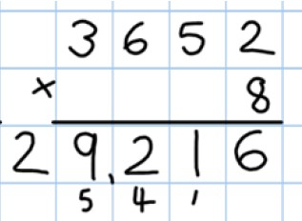

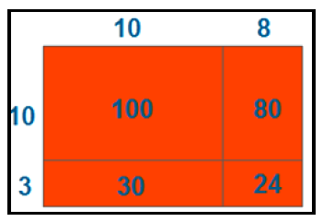


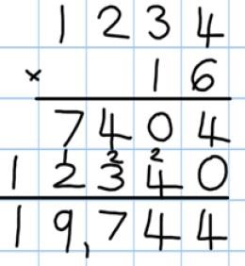
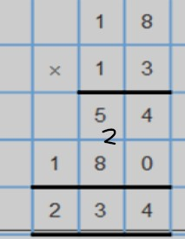



Multiplication
Focus: Multiplying up to 4 digits by 1 or 2 digits
In year 5 children will continue to use short multiplication to solve increasingly richer problems that involve multiplying by 1 digit. They will then move on to long multiplication for problems that involve multiplying by 2 digits. Approximation will play an important part- with children making approximations before using long multiplication to help check their answer is correct.
Children will use short multiplication in a range of increasingly challenging problems. Solving using the grid method and then comparing to the short multiplication method will help cement the children’s understanding of the short multiplication method.
When multiplying by more than 1 digit, children need to use long multiplication. Like with short multiplication, they will solve the problem using the grid method first and then make comparisons until their understanding is secure. In the example below the top row shows 18 x 3 and the bottom shows 18 x 10. The final row shows the total of both calculations.
Once long multiplication methods are secure, children are ready to move on to more challenging problems which require greater levels of mental calculation. The problem to the right show 1234 x 6 on the top line, 1234 x 10 on the bottom line and the total of both calculations on the final row.
Key Vocabulary
Groups of, lots of, times, array, altogether, multiply, count, multiplied by, repeated addition, column, row, commutative, sets of, equal groups, times as big as, once, twice, three times, partition, grid method, multiple, product, tens, units, value, inverse, square, factor, integer, decimal, short/long multiplication, carry
Key Skills
Identify multiples and factors, using secure x table facts to 12 x 12.
Multiply numbers up to 4 digits by a 1 or 2 digit number using formal written methods.
Finding all factor pairs of a number and common factors of 2 numbers
Solve problems where larger numbers are decomposed into their factors.
Multiply and divide integers and decimals by 10,100 and 1000.
Recognise and use square and cube numbers and their notation.
Solve problems that have different combinations of operations, picking the most useful methods.
Year Five

Slide 20

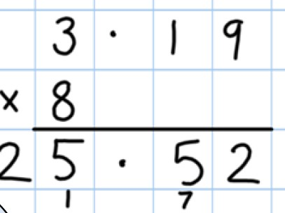

Multiplication
Focus: Consolidating short and long multiplication, multiplying decimals by 1 digit In year 6 children will consolidate all they know about short and long multiplication before they go to Secondary school. They will also learn the new skill of using short multiplication to multiply decimal numbers to 2 decimal places.
When multiplying decimals by whole numbers it is important to remember that the digit you are multiplying by needs to be lined up with the ones digits. As with all decimal work, the decimal points must be lined up and the children need to have a clear understanding why that is.
Key Vocabulary
Groups of, lots of, times, array, altogether, multiply, count, multiplied by, repeated addition, column, row, commutative, sets of, equal groups, times as big as, once, twice, three times, partition, grid method, multiple, product, tens, units, value, inverse, square, factor, integer, decimal, short/long multiplication, carry, tenths, hundredths, decimals
Key Skills
Multiply up to 4 digits by 2 digits using long multiplication.
Solve mixed operation and large number problems using mental methods.
Solve multi step problems involving a range of operations.
Estimate and approximate answers of problems to improve accuracy.
Round any integer to the determined level of accuracy.
Year Six

Slide 21


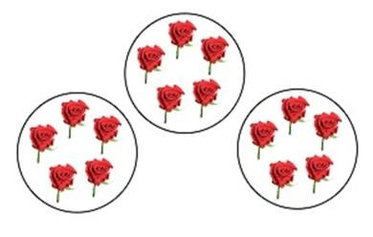


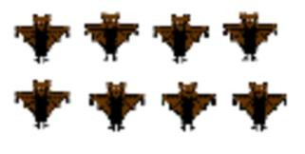

Division
Focus: Grouping and sharing small quantities without remainders
As an introduction to division, children in year 1 will solve problems in familiar and relevant contexts where they have to group and share. They will use objects and pictorial
representations to solve problems and they will begin to use counting in 2s, 5s and 10s to support their problems solving.
A farmer has 15 roses and shares them between 3 friends.
How many roses do they each get?
15 roses shared between 3 = 5 roses each
Children need to learn grouping and sharing alongside each other so they understand how they are linked. Grouping will also help children understand how multiplication can be used to
solve division problems. Contextual problems will strengthen children’s understanding of division.
Bats fly in groups of 2. How many groups of 2 will there be if there are 8 bats?
8 bats shared into groups of 2 = 2 bats in each group
Key Vocabulary
Share, share equally, one each, two each…, group, groups of, lots of, array
Key Skills
Solve one step problems involving multiplication and division using concrete objects with support from adults.
Children use grouping and sharing to understand division and to begin to understand finding simple fractions.
Children make connections between arrays and counting in 2s, 5s and 10s.
Children use halving and understand that this is the same as sharing into 2 equal groups.
Year One

Slide 22


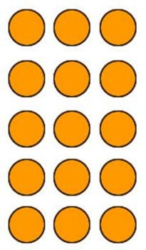

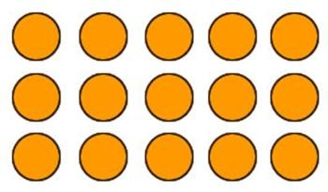



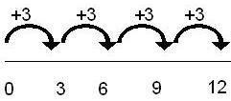

Division
Focus: Grouping and sharing larger quantities using written methods and symbols Children will continue to use the methods of sharing and grouping in division with objects to support their understanding of arrays for sharing and grouping and the division numberline for grouping.
To solve problems such as 15 ÷ 3 =, children will share 15 objects into 3 groups like in the first array or make groups of 3 until they get to 15, like in the second image.
The difference between grouping and sharing should be discussed regularly and visual models and diagrams are very important. Children should solve a variety of contextual problems that will require them to group or share.
Completing both of these processes will help children see the link between sharing and grouping but also the link between 15 ÷ 3 = 5 and 15 ÷ 5 = 3.
Children will start to group on a numberline- which will help cement their understanding of division as grouping. When grouping on a numberline, children will start with a zero at the beginning and will write the dividend at the end of the line, they will then jump in steps of the divisor. The example to the right shows a numberline for the calculation 12 ÷ 3 = 4 as there were 4 jumps of 3 to get to 12.
Key Vocabulary
Share, share equally, one each, two each…, group, groups of, lots of, array, divide, divided by, divided into, division, grouping, number line, left, left over
Key Skills
Count in steps of 2,3 and 5 from 0.
Recall and use x and ÷ facts for the 2,5 and 10 times tables.
Solve division problems and write division number sentences for problems.
Understand that division is not commutative unlike multiplication.
Solve increasingly challenging division problems using concrete objects, arrays, and simple written methods such as grouping on a numberline.
Year Two

Slide 23

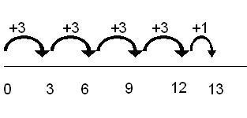






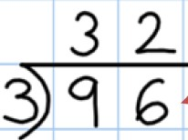

Division
Focus: Dividing 2 digit numbers by 1 digit numbers moving from numberline methods to short division
Children in year 3 will continue to use a numberline to solve division problems and will begin to jump more than one step at a time in the style of ‘chunking’. Once confident they will move on to short division without any remainders.
Children will begin to use the grouping numberline method to solve problems with remainders. They will start on zero and write the dividend at the end of their numberline. They will jump in steps of the divisor until they get as close to the end as possible. Whatever is left over is the remainder. Using cubes or arrays alongside the numberline will consolidate understanding.
Once confident children will begin to solve problems on a grouping numberline involving bigger numbers. To solve this effectively they will need to subtract chunks of the divisor. As you can see in the image for 92 ÷ 4, a step of 10 groups of 4 has been jumped, followed by another step of 10 jumps, finally followed by a step of 3 jumps of 4.
This means that in total 4 was jumped 23 times making 23 the answer.
Once children are confident with numberline methods then they should start work on short division. First of all arrays should be used be used to show a division calculation, the same calculation should then be shown in the short multiplication method. Place value should be regularly discussed so children realize that they are partitioning the dividend and dividing the units then then tens by the divisor.
Initially children will start with simple problems where each digit is a multiple of the divisor.
Key Vocabulary
Share, share equally, one each, two each…, group, groups of, lots of, array, divide, divided by, divided into, division, grouping, number line, left, left over, inverse, short division, carry, remainder, multiple
Key Skills
Recall and use and ÷ facts for the 2,3,4,5,6,8 and 10 x tables (using doubling to connect the 2,4 and 8 x tables)
Solving division problems where a 2 digit number is divided by a 1 digit number using mental and written.
Solve problems in a variety of contexts including missing number problems.
Pupils begin to derive related facts e.g. 9 ÷ 3 = 3 means 90 ÷ 3 = 30 or 90 ÷ 30 = 3.
Pupils develop confidence in written methods, moving from numberlines to short division.
Year Three

Slide 24





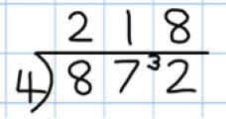
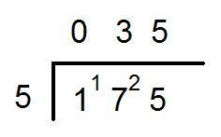



Division
Focus: Consolidating and extending use of short division
Children in year 4 will continue to use short division to solve division problems. They will begin to work on remainders, including problems where there are remainders in the first numbers but not in the final answer.
Once confident with the method of short division, they will move on to problems where the first digit of the dividend is not a multiple of the divisor and therefore a remainder will need to be carried.
Children may need to use other equipment to calculate the division and multiplication facts required.
Children who can use short multiplication problems with remainders (but not those in the final answer) are now ready to work on 3 digit problems. Again, there should be remainders in the calculation but never in the final answer.
Once children are confident at dividing with 3 digits, they need to attempt problems where the answer in the first column (hundreds column) is a zero. They may wish to record the hundred initially as this will help them remember its place and the numbers value.
Key Vocabulary
Share, share equally, one each, two each…, group, groups of, lots of, array, divide, divided by, divided into, division, grouping, number line, left, left over, inverse, short division, carry, remainder, multiple, divisible by, factor Key Skills
Recall multiplication and division facts for all numbers to 12 x 12.
Use place value and known facts to derive facts mentally- including multiplying and dividing by 100, 10 and 1.
Practise mental methods and extend this to three digit numbers using derived facts- e.g. 100 ÷ 5 = 20 so 20 x 5 = 100.
Solve two step problems with increasingly harder numbers in a range of contexts, using language to identify the correct operation.
Correspondence problems should be introduced such as 3 cakes are shared equally between 10 children, 1 man has 6 cats so how many cats do 3 men have etc.
Year Four

Slide 25

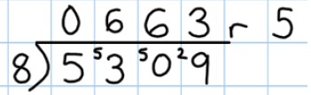



Division
Focus: Extending use of short multiplication to 4 digits and remainders
Children in year 5 will use short division to solve problems up to 4 digits long. For the first time they will use short division to solve problems that have a remainder in the final answer.
In year 5 children will begin to solve division problems where a number up to 4 digits is divided by a single digit number including answers with remainders. These division problems need to be contextual so the children learn how to express the remainder- as a number, a fraction, a decimals, rounded up or rounded down.
Key Vocabulary
Share, share equally, one each, two each…, group, groups of, lots of, array, divide, divided by, divided into,
division, grouping, number line, left, left over, inverse, short division, carry, remainder, multiple, divisible by,
factor, quotient, prime number, prime factors, composite number (non-prime)
Key Skills
Multiply and divide numbers mentally, using known facts.
Divide numbers up to 4 digits by a 1 digit number using formal written methods.
Identify multiples and factors, including all factor pairs of a number and common factors between 2 numbers.
Solve x and ÷ problems where larger numbers are decomposed into their factors.
Multiply and divide whole numbers and decimals by 10, 100 and 1000.
Use vocabulary of prime numbers, prime factors and composite numbers.
Work out whether a number up to 100 is prime and know all prime numbers to 30.
Use and understand multiplication and division as inverses.
Present division with remainders answers differently, showing the remainder as a fraction, decimal or whole number
by rounding.
Solve problems with a combination of all four operations including fraction scaling problems and problems involving simple rates.
Year Five

Slide 26

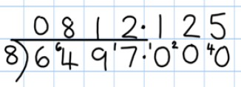




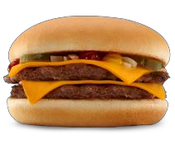
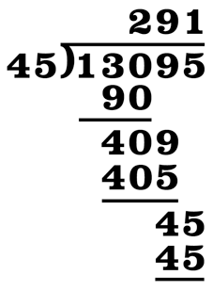

Division
Focus: Using short division to divide 4 digit numbers and express remainders as decimals and long division for dividing 2 digit numbers
In year 6, children will use short division to divide decimal numbers by single digit numbers. The final step of division will be long division which will be used to divide numbers by 2 digits.
The focus in year 6 is not so much the method of short division but how the remainders are expressed- children need to express remainders as
decimals and fractions- depending on the context of the question.
The remainder in this answer would
have been 1 but it has been expressed as a decimal. To do this, children need to insert a decimal point next to the units and carry the remainder over the decimal point. Zeroes are inserted to the right of the decimal point to show that there was no value.
A great way of remembering the steps of long division is Does Mcdonalds Serve Burgers?
To divide by 2 digit numbers, the children will use the method of long division. The example to the right clearly shows the method in the ‘Burger’ steps, where as the example to the left shows what a completed method would look like. Any remainders would need to be expressed in a way that matched the context of the problem.
Key Vocabulary
Share, share equally, one each, two each…, group, groups of, lots of, array, divide, divided by, divided into, division, grouping, number line, left, left over, inverse, short division, carry, remainder, multiple, divisible by, factor, quotient, prime number, prime factors, composite number (non-prime), common factor
Key Skills
Use multiplication and division facts up to 12 x 12 to solve more complex problems.
Decide when to use short or long division and interpret remainders in a way that is appropriate to the problem.
Perform mental calculations for problems involving large numbers and mixed calculations.
Identify common factors, common multiples and prime numbers.
Use estimation to check answers to calculations and determine accuracy.
Use written methods of division to solve decimal problems up to 2 decimal places.
Solve problems which require rounding to 10, 100, 1000 and beyond.
Year Six

