Slide 1
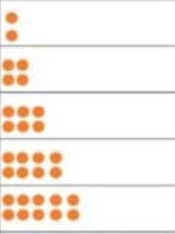
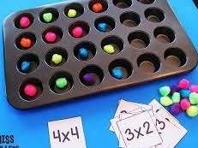

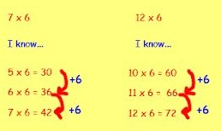
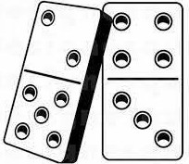
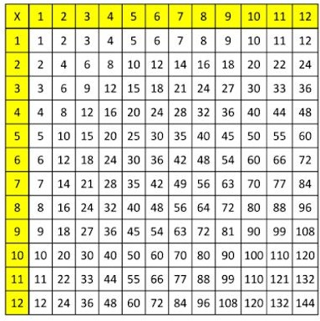
Below is a list of activities you can use to learn your multiplications and their division facts.
Year 2 – 2’s, 5’s and 10’s
Year 3 – 3’s, 4’s and 8’s
Year 4 – 6’s, 7’s, 9’s, 11’s and 12’s
P ictorial representations Draw your multiplications / division facts out using pictures. These can be dots, sweets etc. | C oncrete resources Make your multiplications / division facts using resources from around the house. eg. pasta, pencils, sweets, rice, money, egg boxes, ice trays. | C onnection seeking Find the connection between the multiplications (focus on the ones learnt): 5’s & 10’s 2’s & 4’s & 8’s 3’s & 6’s & 12’s
P attern Seeking Write out your multiplications. Can you find a pattern? Is there a rule? Hint: Odd / Even | C lose Multiples Use your multiplications to help you figure out others. | B eat the clock Set the timer. See how quickly you can answer all your multiplications. Can you beat your own score?
W ord Problem Make a word problem out of your multiplication / division fact. “35 ÷ 5 = 7 I’m baking cupcakes. I make 5 cupcakes. I decorate them evenly with 35 sweets. How many sweets are on each cupcake?” | D ominoes Put all the dominos face down. Flip one over and multiply the two numbers together. 2 x 5 = 10 4 x 3 = 12 A point for every correct answer. | M atching Write out all of the multiplications / division on separate pieces of paper. Write all the answers on separate pieces of paper. Put them al face down. Take it turns to turn the paper over and match the question to the answer.
B ingo Write down numbers on your board / paper. Someone calls out multiplications / divisions facts. When all your numbers have been called, shout BINGO! | R ecipes Get a recipe. Make it for more people. Eg a recipe for 2 people. Make it for 6. You will need to multiply all the ingredients by 3. A recipe for 4 people, make it for 8. You will need to double all the ingredients. | M ultiplication grid Get a 12 x 12 multiplication grid. See how quickly or how much you can fill in.
5 | 2 | 6 | 10 ÷ 2? 8 x 8? 3 x 7?
1 | 24 | 10
21 | 56 | 81
Web based activities:
T imes tables rock stars https://ttrockstars.com/ Children have their own logins | H it the button https://www.topmarks.co.uk/mat hs-games/hit-the-button | F unky mummy https://www.ictgames.com/mobi lePage/funkyMummy/index.html

